Slide 1
Google Cloud Natural Language API
Dr. Noman Islam
Institute of Applied AI Engineers

Slide 2
Setting up your Google cloud account
Create a google cloud account using your gmail id
Enable the respective API on your project
Enable billing for your project

Slide 3
Setting up a python development environment

Slide 4
Install latest versions of python 2
> python --version Python 2.7.13 > pip --version pip 9.0.1 from c:\python27\lib\site-packages (Python 2.7.13)

Slide 5
Installing and using virtualenv
pip install --upgrade virtualenv
cd your-project
virtualenv --python "c:\python27\python.exe" env
.\env\Scripts\activate

Slide 6
Install Google cloud SDK

Slide 7
Install Google cloud client library for python
pip install --upgrade google-cloud-storage

Slide 8
Installing the client library
pip install --upgrade google-cloud-language

Slide 9
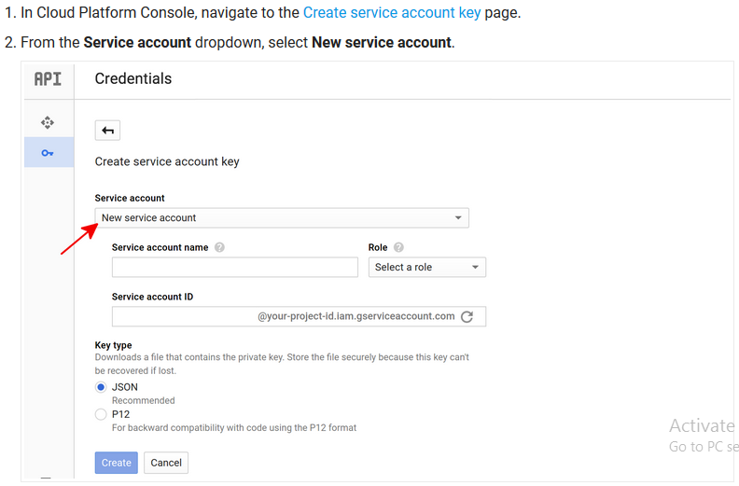
Set up authentication

Slide 10
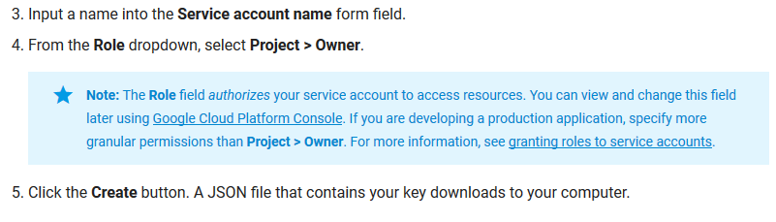

Slide 11
Using a service account in your application
Next, provide the credentials to your application code by setting the environment variable GOOGLE_APPLICATION_CREDENTIALS to point to the JSON file you downloaded in the previous step.
set GOOGLE_APPLICATION_CREDENTIALS=<path_to_service_account_file>

Slide 12
Introduction
The Natural Language API has several methods for performing analysis and annotation on your text.
Each level of analysis provides valuable information for language understanding. These methods are listed below

Slide 13
Sentiment analysis inspects the given text and identifies the prevailing emotional opinion within the text, especially to determine a writer's attitude as positive, negative, or neutral.
Sentiment analysis is performed through the analyzeSentiment method.

Slide 14
Entity analysis inspects the given text for known entities (Proper nouns such as public figures, landmarks, and so on. Common nouns such as restaurant, stadium, and so on.) and returns information about those entities.
Entity analysis is performed with the analyzeEntities method.

Slide 15
Entity sentiment analysis inspects the given text for known entities (proper nouns and common nouns), returns information about those entities, and identifies the prevailing emotional opinion of the entity within the text, especially to determine a writer's attitude toward the entity as positive, negative, or neutral.
Entity analysis is performed with the analyzeEntitySentiment method.

Slide 16
Syntactic analysis extracts linguistic information, breaking up the given text into a series of sentences and tokens (generally, word boundaries), providing further analysis on those tokens. Syntactic Analysis is performed with the analyzeSyntax method.

Slide 17
Content classification (beta) analyzes text content and returns a content category for the content.
Content classification is performed by using the classifyText method.

Slide 18
Basic natural language request
{ "document":{ "type":"PLAIN_TEXT", "language": "EN", "content":"'Lawrence of Arabia' is a highly rated film biography about \ British Lieutenant T. E. Lawrence. Peter O'Toole plays \ Lawrence in the film." }, "encodingType":"UTF8" }

Slide 19
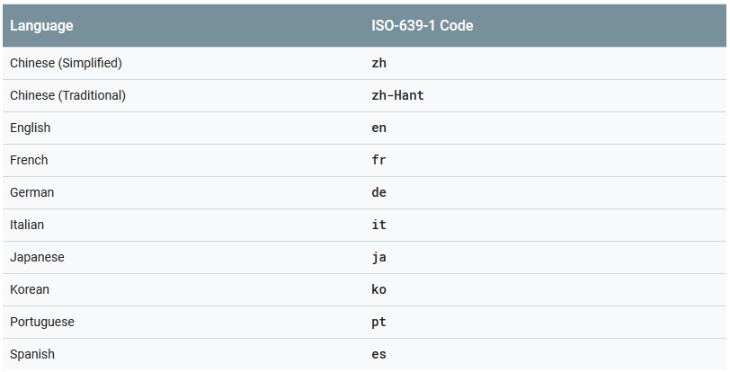
Languages supported

Slide 20
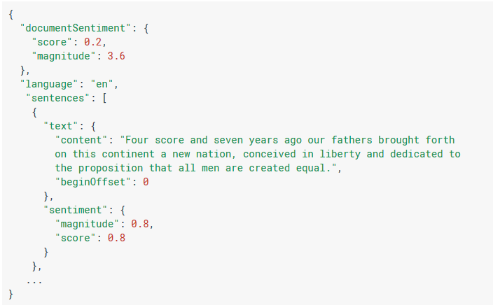
Sentiment analysis response

Slide 21
documentSentiment contains the overall sentiment of the document, which consists of the following fields:
score of the sentiment ranges between -1.0 (negative) and 1.0 (positive) and corresponds to the overall emotional leaning of the text.
magnitude indicates the overall strength of emotion (both positive and negative) within the given text, between 0.0 and +inf. Unlike score, magnitude is not normalized; each expression of emotion within the text (both positive and negative) contributes to the text's magnitude (so longer text blocks may have greater magnitudes).

Slide 22
language contains the language of the document, either passed in the initial request, or automatically detected if absent.

Slide 23
sentences contains a list of the sentences extracted from the original document, which contains:
sentiment contains the sentence level sentiment values attached to each sentence, which contain score and magnitude values as described above.

Slide 24
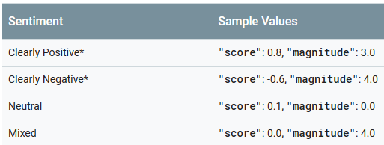
Sample values of sentiment analysis

Slide 25
Entity analysis
Entity Analysis provides information about entities in the text, which generally refer to named "things" such as famous individuals, landmarks, common objects, etc.
Entities broadly fall into two categories: proper nouns that map to unique entities (specific people, places, etc.) or common nouns (also called "nominals" in natural language processing).

Slide 26
Entity response
Entity analysis returns a set of detected entities, and parameters associated with those entities, such as the entity's type, relevance of the entity to the overall text, and locations in the text that refer to the same entity.
Entities are returned in the order (highest to lowest) of their salience scores, which reflect their relevance to the overall text.

Slide 27
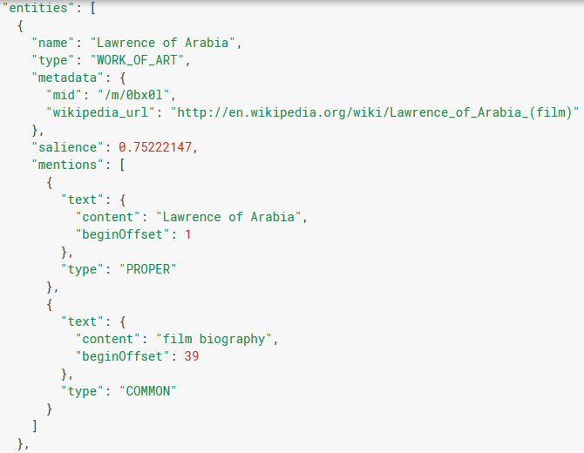
Snapshot of sample entity response

Slide 28
type indicates the type of this entity (for example if the entity is a person, location, consumer good, etc.)
This information helps distinguish and/or disambiguate entities, and can be used for writing patterns or extracting information.
For example, a type value can help distinguish similarly named entities such as “Lawrence of Arabia”, tagged as a WORK_OF_ART (film), from “T.E. Lawrence”, tagged as a PERSON, for example. (See Entity Types for more information.)

Slide 29
metadata contains source information about the entity's knowledge repository Additional repositories may be exposed in the future. This field may contain the following subfields:
wikipedia_url, if present, contains the Wikipedia URL pertaining to this entity.
mid, if present, contains a machine-generated identifier (MID) corresponding to the entity's Google Knowledge Graph entry. Note that mid values remain unique across different languages, so you can use such values to tie entities together from different languages. For inspecting these MID values, please consult the Google Knowledge Graph Search API documentation.

Slide 30
salience indicates the importance or relevance of this entity to the entire document text.
This score can assist information retrieval and summarization by prioritizing salient entities.
Scores closer to 0.0 are less important, while scores closer to 1.0 are highly important.

Slide 31
mentions indicate offset positions within the text where an entity is mentioned.
This information can be useful if you want to find all mentions of the person “Lawrence” in the text but not the film title. You can also use mentions to collect the list of entity aliases, such as “Lawrence,” that refer to the same entity “T.E. Lawrence”. An entity mention may be one of two types: PROPER or COMMON.
A proper noun Entity for "Lawrence of Arabia," for example, could be mentioned directly as the film title, or as a common noun ("film biography" of T.E. Lawrence).

Slide 32
Entity sentiment analysis
Entity sentiment analysis combines both entity analysis and sentiment analysis and attempts to determine the sentiment (positive or negative) expressed about entities within the text.
Entity sentiment is represented by numerical score and magnitude values and is determined for each mention of an entity.
Those scores are then aggregated into an overall sentiment score and magnitude for an entity.

Slide 33
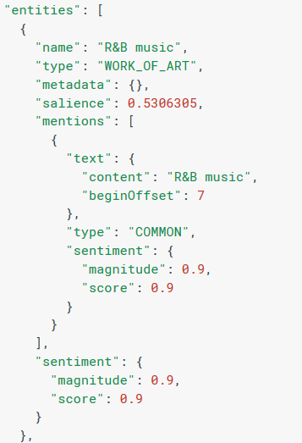
Snapshot of entity sentiment analysis response

Slide 34
Syntactic analysis
The Natural Language API provides a powerful set of tools for analyzing and parsing text through syntactic analysis. To perform syntactic analysis, use the analyzeSyntax method.
Syntactic Analysis consists of the following operations:
Sentence extraction breaks up the stream of text into a series of sentences.
Tokenization breaks the stream of text up into a series of tokens, with each token usually corresponding to a single word.
The Natural Language API then processes the tokens and, using their locations within sentences, adds syntactic information to the tokens.

Slide 35
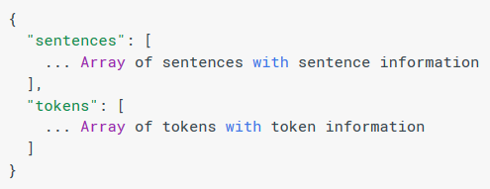
Syntax analysis response

Slide 36
Content classification
You can have the Natural Language API analyze a document and return a list of content categories that apply to the text found in the document.
To classify the content in a document, call the classifyText method.

Slide 37
Analyze sentiment
# Imports the Google Cloud client library
from google.cloud import language
from google.cloud.language import enums
from google.cloud.language import types
import six
def sentiment_text(text):
"""Detects sentiment in the text."""
client = language.LanguageServiceClient()
if isinstance(text, six.binary_type):
text = text.decode('utf-8')
# Instantiates a plain text document.

Slide 38
document = types.Document(
content=text,
type=enums.Document.Type.PLAIN_TEXT)
# Detects sentiment in the document. You can also analyze HTML with:
# document.type == enums.Document.Type.HTML
sentiment = client.analyze_sentiment(document).document_sentiment
print('Score: {}'.format(sentiment.score))
print('Magnitude: {}'.format(sentiment.magnitude))
sentiment_text("I am very sad these days")

Slide 39
Analyze entity
# Imports the Google Cloud client library
from google.cloud import language
from google.cloud.language import enums
from google.cloud.language import types
import six
def entities_text(text):
"""Detects entities in the text."""
client = language.LanguageServiceClient()
if isinstance(text, six.binary_type):
text = text.decode('utf-8')
# Instantiates a plain text document.
document = types.Document(
content=text,
type=enums.Document.Type.PLAIN_TEXT)

Slide 40
# Detects entities in the document. You can also analyze HTML with:
# document.type == enums.Document.Type.HTML
entities = client.analyze_entities(document).entities
# entity types from enums.Entity.Type
entity_type = ('UNKNOWN', 'PERSON', 'LOCATION', 'ORGANIZATION',
'EVENT', 'WORK_OF_ART', 'CONSUMER_GOOD', 'OTHER')
for entity in entities:
print('=' * 20)
print(u'{:<16}: {}'.format('name', entity.name))
print(u'{:<16}: {}'.format('type', entity_type[entity.type]))
print(u'{:<16}: {}'.format('metadata', entity.metadata))
print(u'{:<16}: {}'.format('salience', entity.salience))
print(u'{:<16}: {}'.format('wikipedia_url',
entity.metadata.get('wikipedia_url', '-')))
entities_text("Bill and Jimmy are working on my project")

Slide 41
Analyze entity sentiment
# Imports the Google Cloud client library
from google.cloud import language
from google.cloud.language import enums
from google.cloud.language import types
import six
import sys
def entity_sentiment_text(text):
"""Detects entity sentiment in the provided text."""
client = language.LanguageServiceClient()
if isinstance(text, six.binary_type):
text = text.decode('utf-8')
document = types.Document(
content=text.encode('utf-8'),
type=enums.Document.Type.PLAIN_TEXT)
# Detect and send native Python encoding to receive correct word offsets.
encoding = enums.EncodingType.UTF32
if sys.maxunicode == 65535:
encoding = enums.EncodingType.UTF16

Slide 42
result = client.analyze_entity_sentiment(document, encoding)
for entity in result.entities:
print('Mentions: ')
print(u'Name: "{}"'.format(entity.name))
for mention in entity.mentions:
print(u' Begin Offset : {}'.format(mention.text.begin_offset))
print(u' Content : {}'.format(mention.text.content))
print(u' Magnitude : {}'.format(mention.sentiment.magnitude))
print(u' Sentiment : {}'.format(mention.sentiment.score))
print(u' Type : {}'.format(mention.type))
print(u'Salience: {}'.format(entity.salience))
print(u'Sentiment: {}\n'.format(entity.sentiment))
entity_sentiment_text("Bill and Jimmy are sad these days")

Slide 43
Syntax analysis
# Imports the Google Cloud client library
from google.cloud import language
from google.cloud.language import enums
from google.cloud.language import types
import six
def syntax_text(text):
"""Detects syntax in the text."""
client = language.LanguageServiceClient()
if isinstance(text, six.binary_type):
text = text.decode('utf-8')
# Instantiates a plain text document.
document = types.Document(
content=text,
type=enums.Document.Type.PLAIN_TEXT)
# Detects syntax in the document. You can also analyze HTML with:
# document.type == enums.Document.Type.HTML
tokens = client.analyze_syntax(document).tokens

Slide 44
# part-of-speech tags from enums.PartOfSpeech.Tag
pos_tag = ('UNKNOWN', 'ADJ', 'ADP', 'ADV', 'CONJ', 'DET', 'NOUN', 'NUM',
'PRON', 'PRT', 'PUNCT', 'VERB', 'X', 'AFFIX')
for token in tokens:
print(u'{}: {}'.format(pos_tag[token.part_of_speech.tag],
token.text.content))
syntax_text("The brown fox jumps quickly over the lazy dog")

Slide 45
Classify text
from google.cloud import language_v1beta2
from google.cloud.language_v1beta2 import enums
from google.cloud.language_v1beta2 import types
import six
client = language_v1beta2.LanguageServiceClient()
def classify_text(text):
"""Classifies content categories of the provided text."""
client = language_v1beta2.LanguageServiceClient()
if isinstance(text, six.binary_type):
text = text.decode('utf-8')
document = types.Document(
content=text.encode('utf-8'),
type=enums.Document.Type.PLAIN_TEXT)
categories = client.classify_text(document).categories

Slide 46
for category in categories:
print(u'=' * 20)
print(u'{:<16}: {}'.format('name', category.name))
print(u'{:<16}: {}'.format('confidence', category.confidence))
classify_text("The threat of nuclear attack from North Korea is increasing, US Defence Secretary James Mattis said during a visit to South Korea. Mr Mattis warned it would face a 'massive military response' if it used nuclear weapons. Separately, North Korea released a South Korean fishing boat which it said had been found in North Korean waters illegally.")

